Slide 1

POINTER TYPE IN C#

Slide 2
What is Pointer Type in C#?
Also know as a locator or indicator that points to an address of the value which means pointer-type variable stores the memory address of another type
We have two Symbols ampersand (&) and asterisk(*)
Ampersand(&) – It is used to determine the address of a variable
Asterisk (*) – It is used to access the value of an address

Slide 3
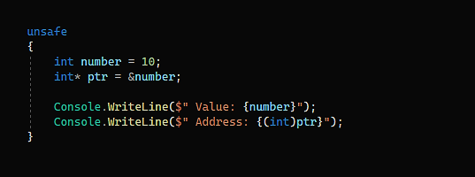

Example:
Below code can only run in unsafe mode, to enable safe mode go to project properties > deBug and check unsafe code.

